Slide 1

Case Study on Comparison of model predictive and advanced PID control
Nagaraj Prakash - 11139349
Prathamesh Kolekar - 11139708
Srinidhi Subbanna - 11138941

Slide 2
Agenda
Introduction
Unisim Plant - Override Control
Different Control Strategy- Model Predictive Control
Model Predictive Control in Python
OPC DA Protocol
Comparison of Override and MPC
Challenges and future work

Slide 3
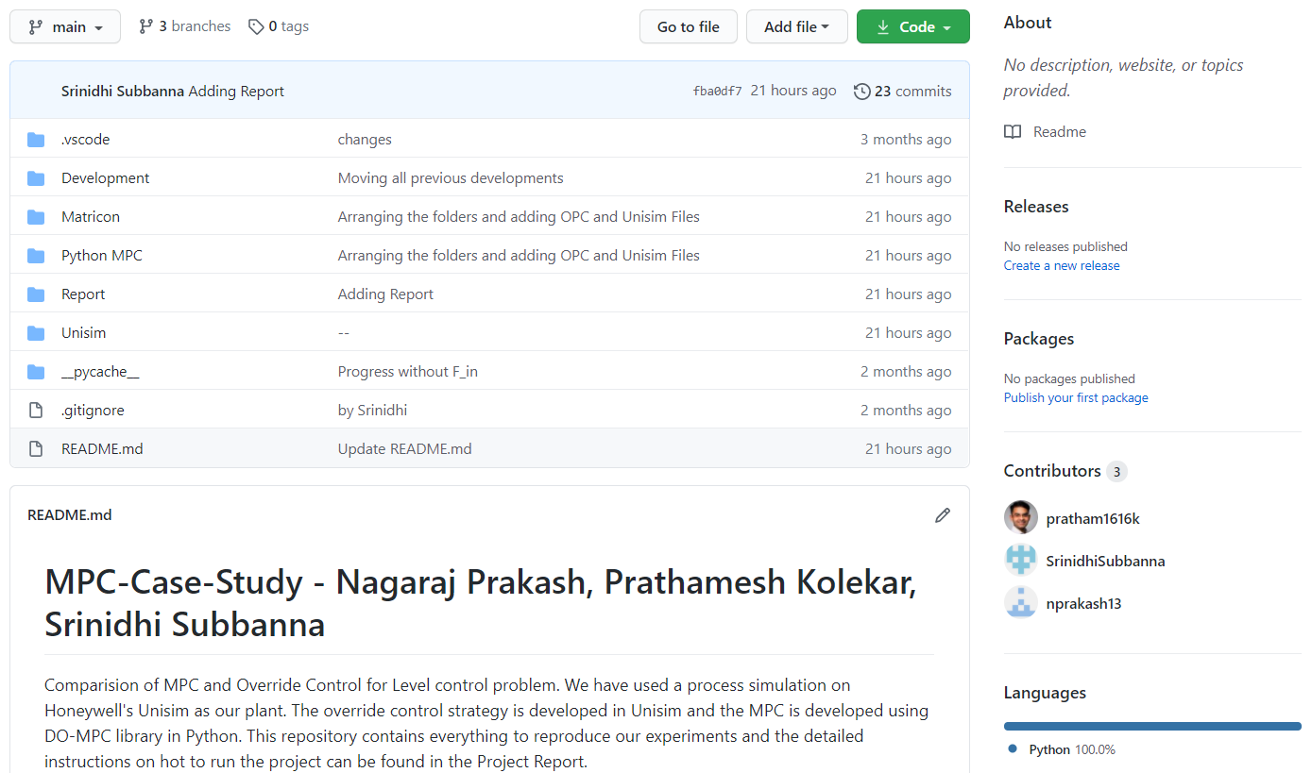
List of software used
1. Unisim R451
2. Python 3.8 (32-bit)
3. Matrikon OPC Server for Simulation
4. Matrikon OPC Explorer
5. GitHub
6. Visual Studio Code

Slide 4
Introduction – Control Problem
Advanced PID controller vs Model Predictive Control
Simple process – Liquid Level Control
Usual way – Advanced PID control methods like Cascade, Override, Ratio control
Studying the applicability of the MPC for Level Control Problem
Usual Practice in Industry for Level Control – Cascade Control
Primary loop – Level Control || Secondary Loop – Flow Control
This structure manages the influence of disturbances like inflow better than just a PID level controller
Control Problem – Level Control between 20% to 80%

Slide 5
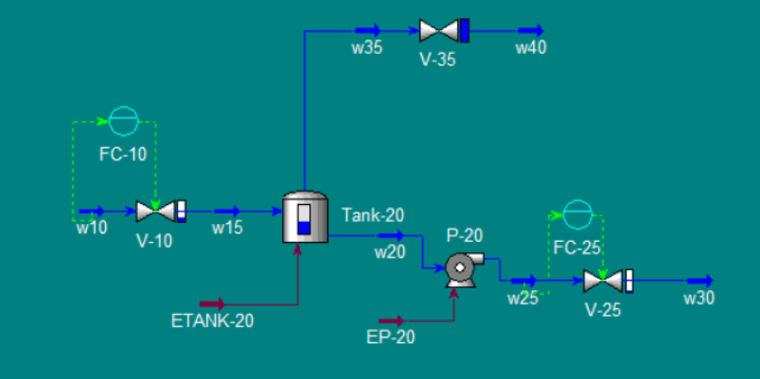
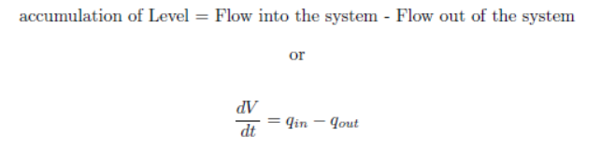
Introduction – Unisim Plant
Inlet Valve – 0 to 50 m³/hr
Tank – 10 m³
Outlet Valve – 0 to 50 m³/hr
Pump – renders the inlet pressure to V-25 constant

Slide 6
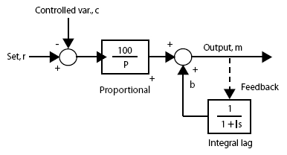
Advanced PID Control strategy
PID flow controller is cascaded with an Override Level Controller.
All controller are PI controllers.
The Override Controller uses a PI Controller with External Reset
Source: https://www.controlglobal.com/articles/2006/095/

Slide 7
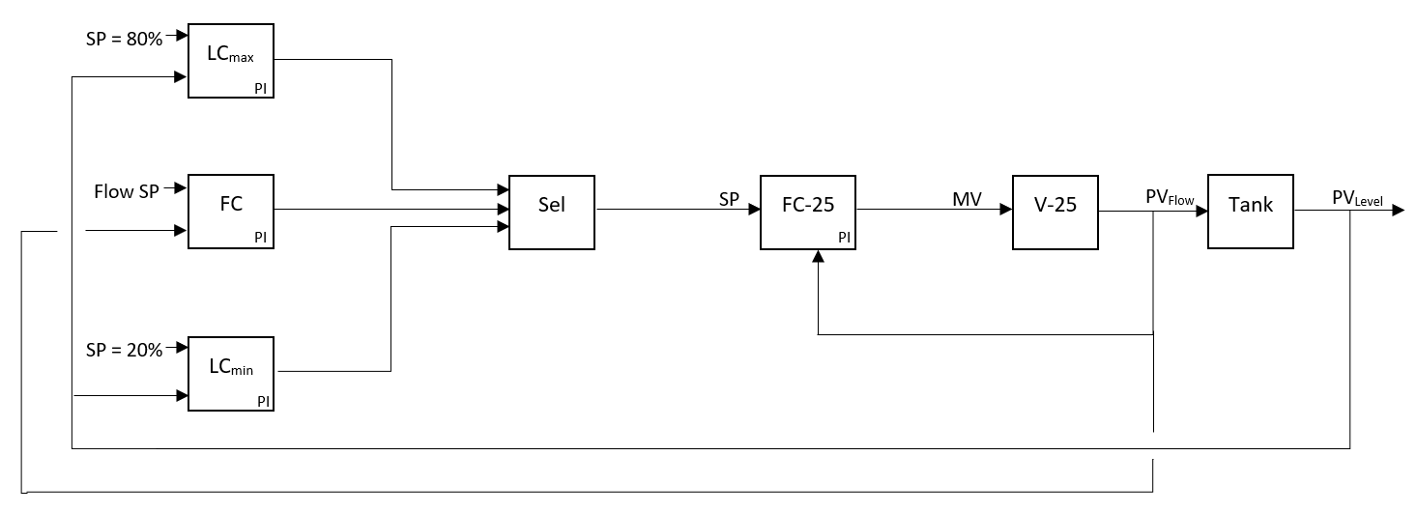
Advanced PID Control – Overall Structure

Slide 8
Advanced PID Control – Selection Criteria
The Override Controller’s P part is calculated in the spreadsheet
All 3 controller of the Override control use the same Lag to provide stationary set point.
LCmax and LCmin has negative gains.
P part of LCmax is positive when Level > 80%
P part of LCmin is negative when Level < 20%
Max(LCmax, Min(LCmin, FC))

Slide 9
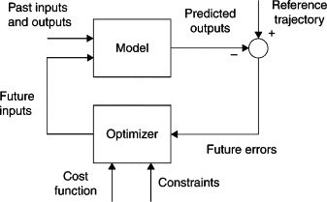
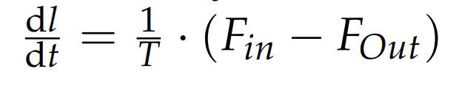
Model Predictive Control- Model
Solving Control Problem using Optimization technique
PV as Level and MV as Flow out
Building Model of Plant using ODE.
Optimizer to solve linear optimization problem involving level and flow_out.
Identification of states and parameters
state x in model = Level of tank (l) = L
Input u in model = outlet flow = F_out
Parameter p in model = inlet flow (which is uncertain parameter) = F_in
Time constant in model = T = 60 mins. or 1 hr (Which is fixed parameter)

Slide 10
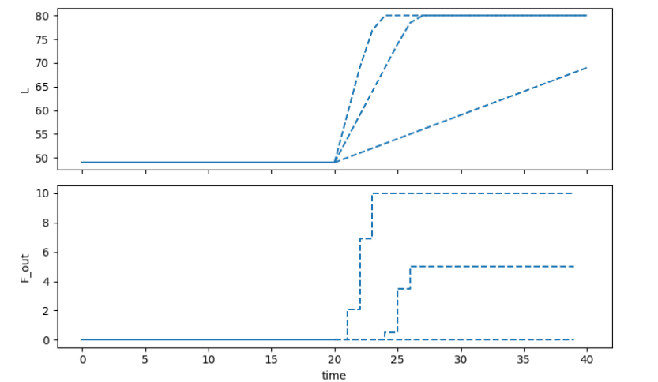
Model Predictive Control- Controller tunning
Different tunning parameters
n_horizon = 20 steps
t_step = 1
Solver=MUMPS/MA27 linear solver
(Multifrontal Massively Parallel sparse direct solver)
State discretization: collocation method
MPC running after 5 secs

Slide 11
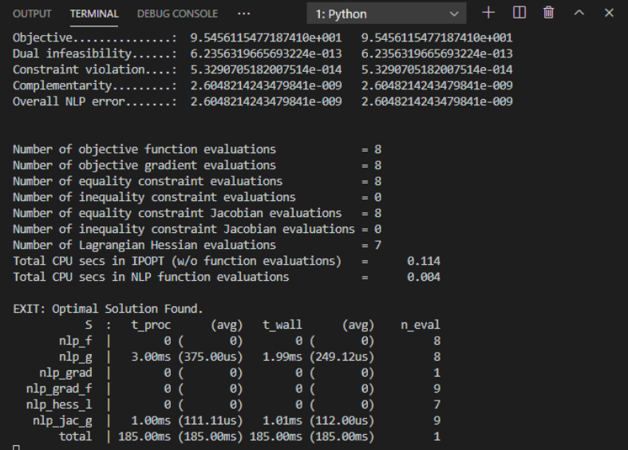



Model Predictive Control- Optimizer
Control Objective and formation of objective function
Cost function
Langragian
Meyer
Input penalty – To smooth the obtained optimal solution
Constraints
Lower bound = 20% level
Higher bound = 80% level

Slide 12
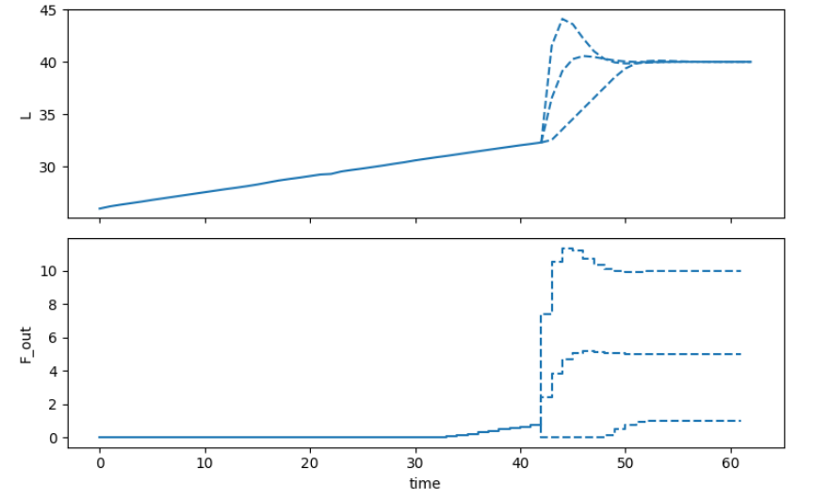
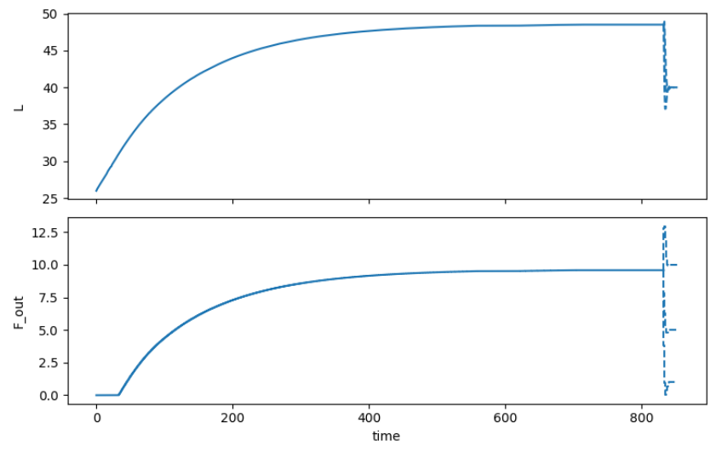
Model Predictive Control : Results
Optimal level of tank = 40% , began at 24%, level maintained at 48.50%
Prediction Optimization

Slide 13
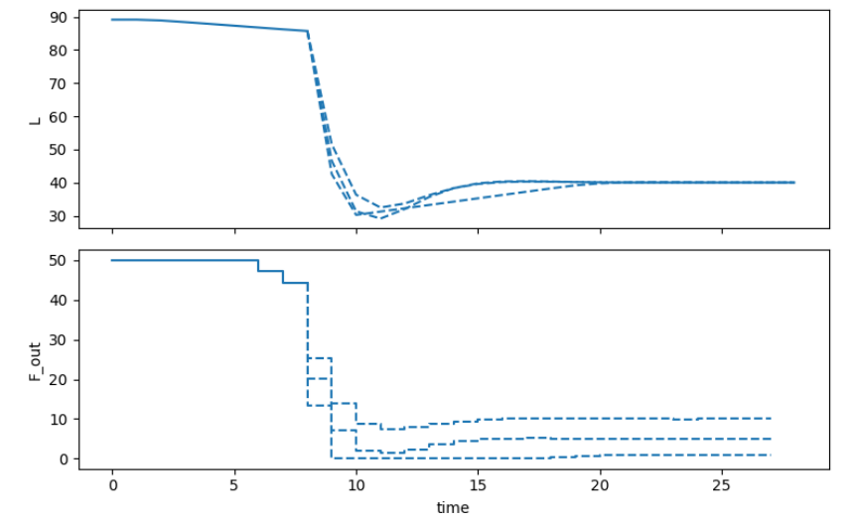
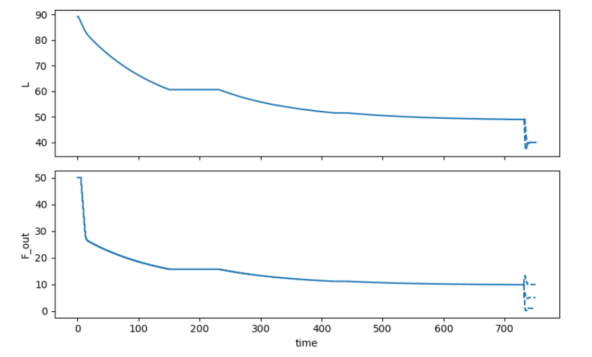
Model Predictive Control : Results
Optimal level of tank = 40% , began at 90%, level maintained at 50%
Prediction Optimization

Slide 14
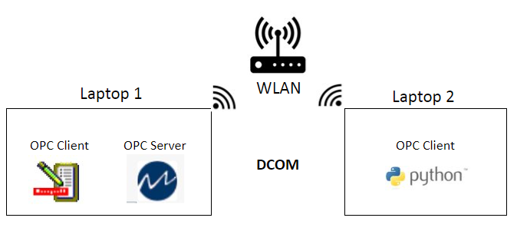
OPC (Open Platform Communications)
OPC is a language for the communication between machines in industries
Client-server-based communication

Slide 15
DCOM Settings
Installing OPC core components
Configure your computer to be a member of your Network
System-wide DCOM Setup
Window Defender Firewall specific DCOM Setup
OPCEnum and Matrikon OPC DA setup
Configure Local Security Policies
Configuration of DCOM is done on both server and client machines

Slide 16
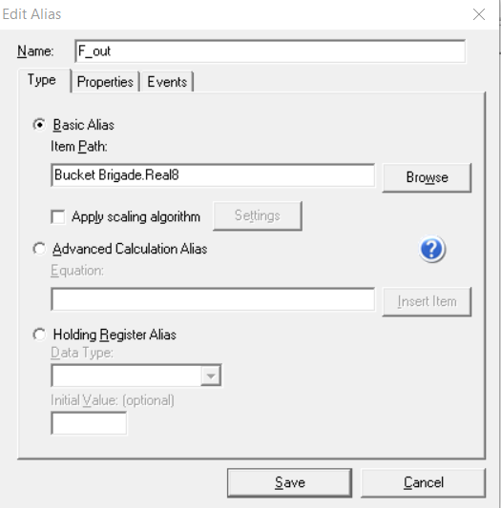
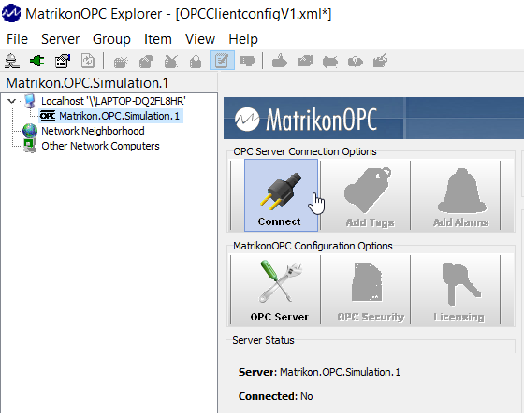
Matrikon OPC DA server
1. Configuring Alias for OPC Variables
2. OPC DA client from Matrikon

Slide 17
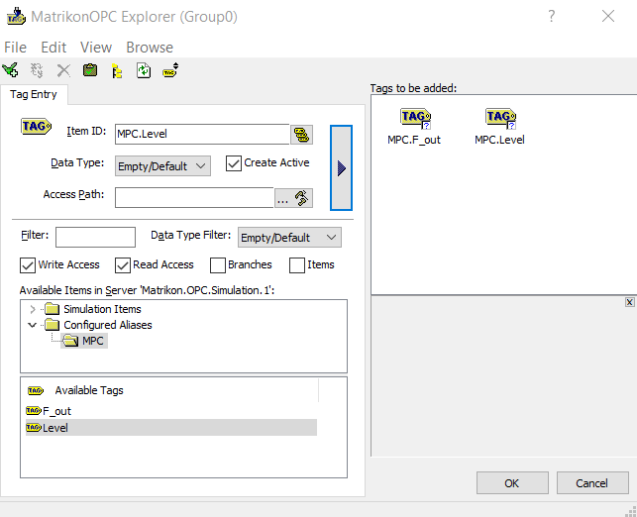
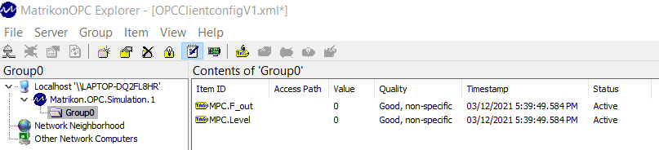
Matrikon OPC DA server
3. Browsing server objects on client
4. Tag monitoring on the OPC client

Slide 18
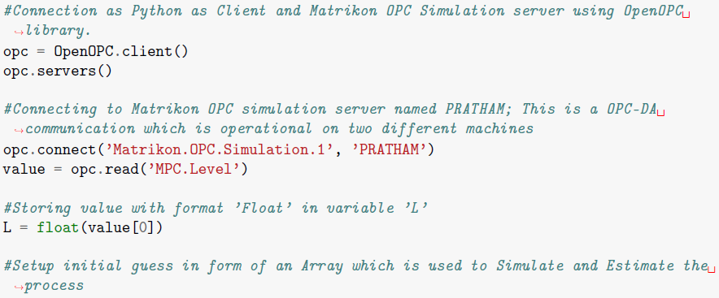
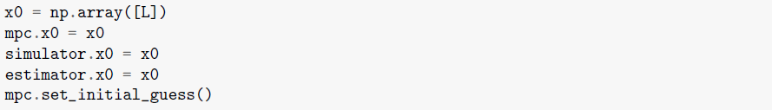
OPC DA in Python
Connecting to OPC-DA server and setting up initial state
• Importing OpenOPC library
• Read the PV(MPC.Level)
• Write the OP(MPC.F_Out)

Slide 19
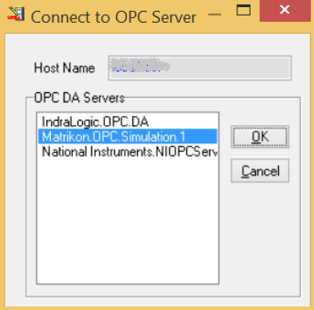
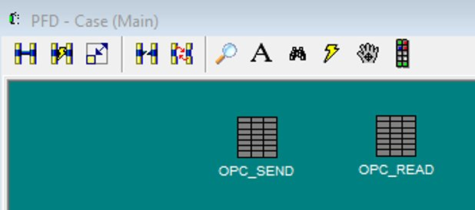
OPC DA in Unisim
1. Creation of Spreadsheet
2. Establishing a connection to the OPC Server

Slide 20
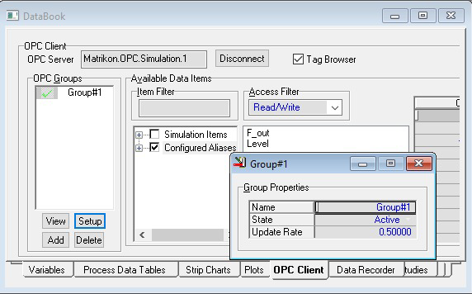
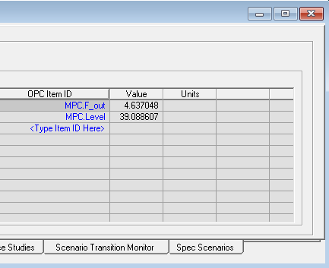
OPC DA in Unisim
3. Managing the tags from Python

Slide 21
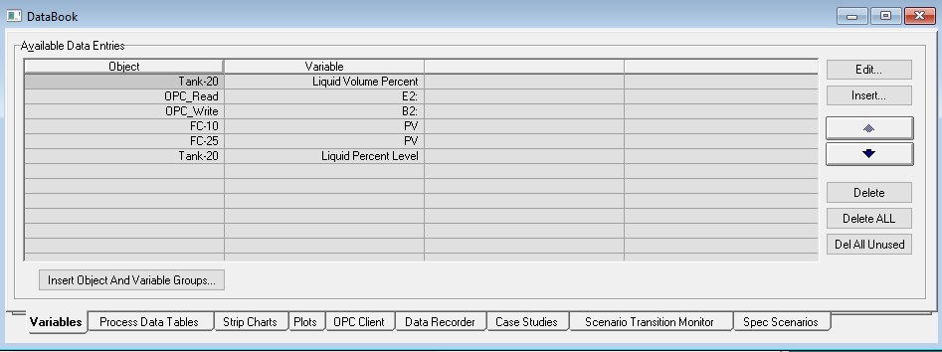
OPC DA in Unisim
4. Creation of variables

Slide 22
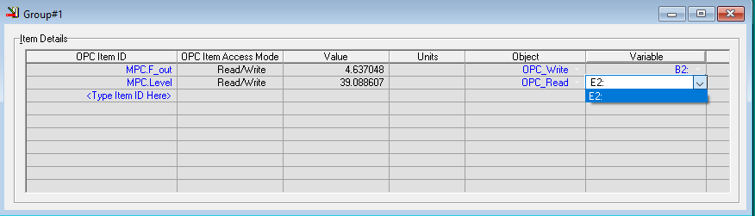
OPC DA in Unisim
5. Assigning the created variables to the OPC Tags

Slide 23
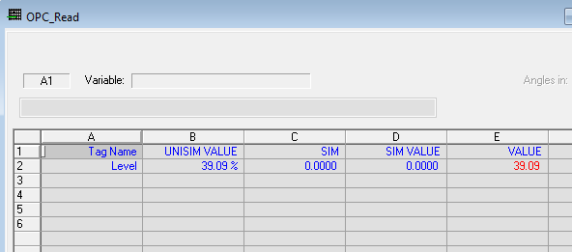
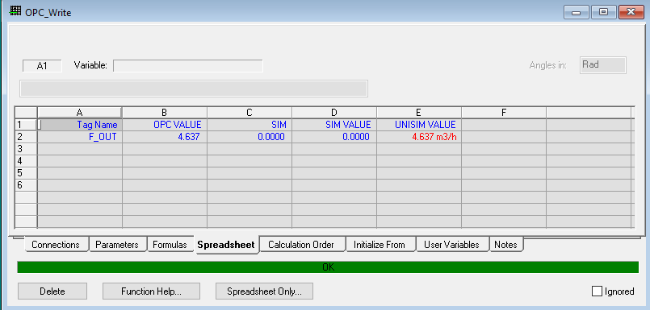
OPC DA in Unisim
6. Reading and Sending OPC values

Slide 24
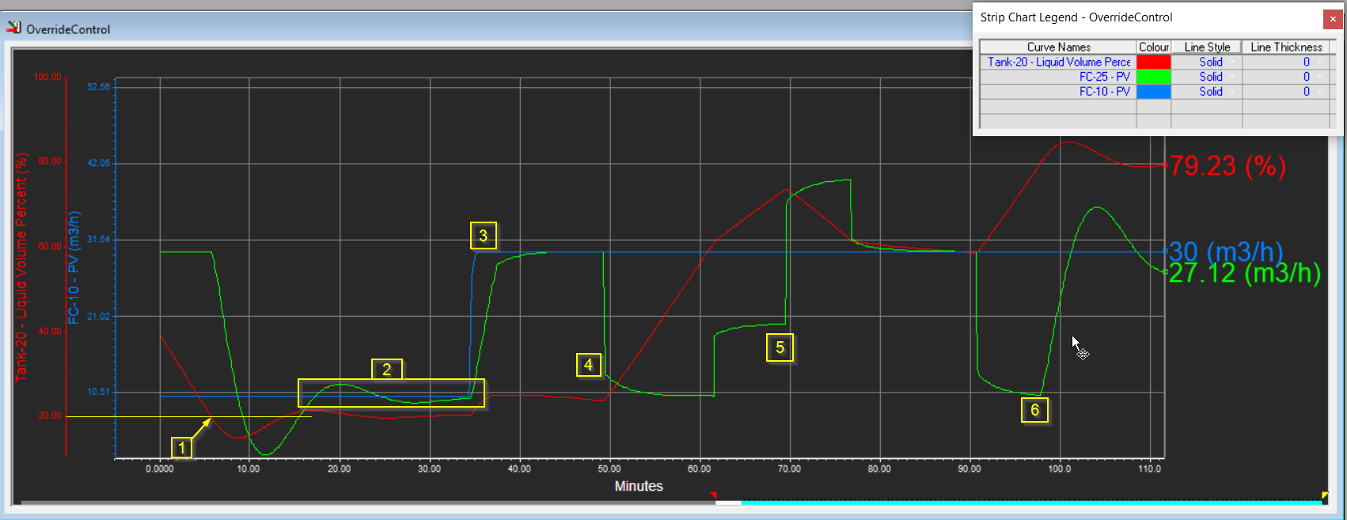
Comparison of Override and MPC
Override Control

Slide 25
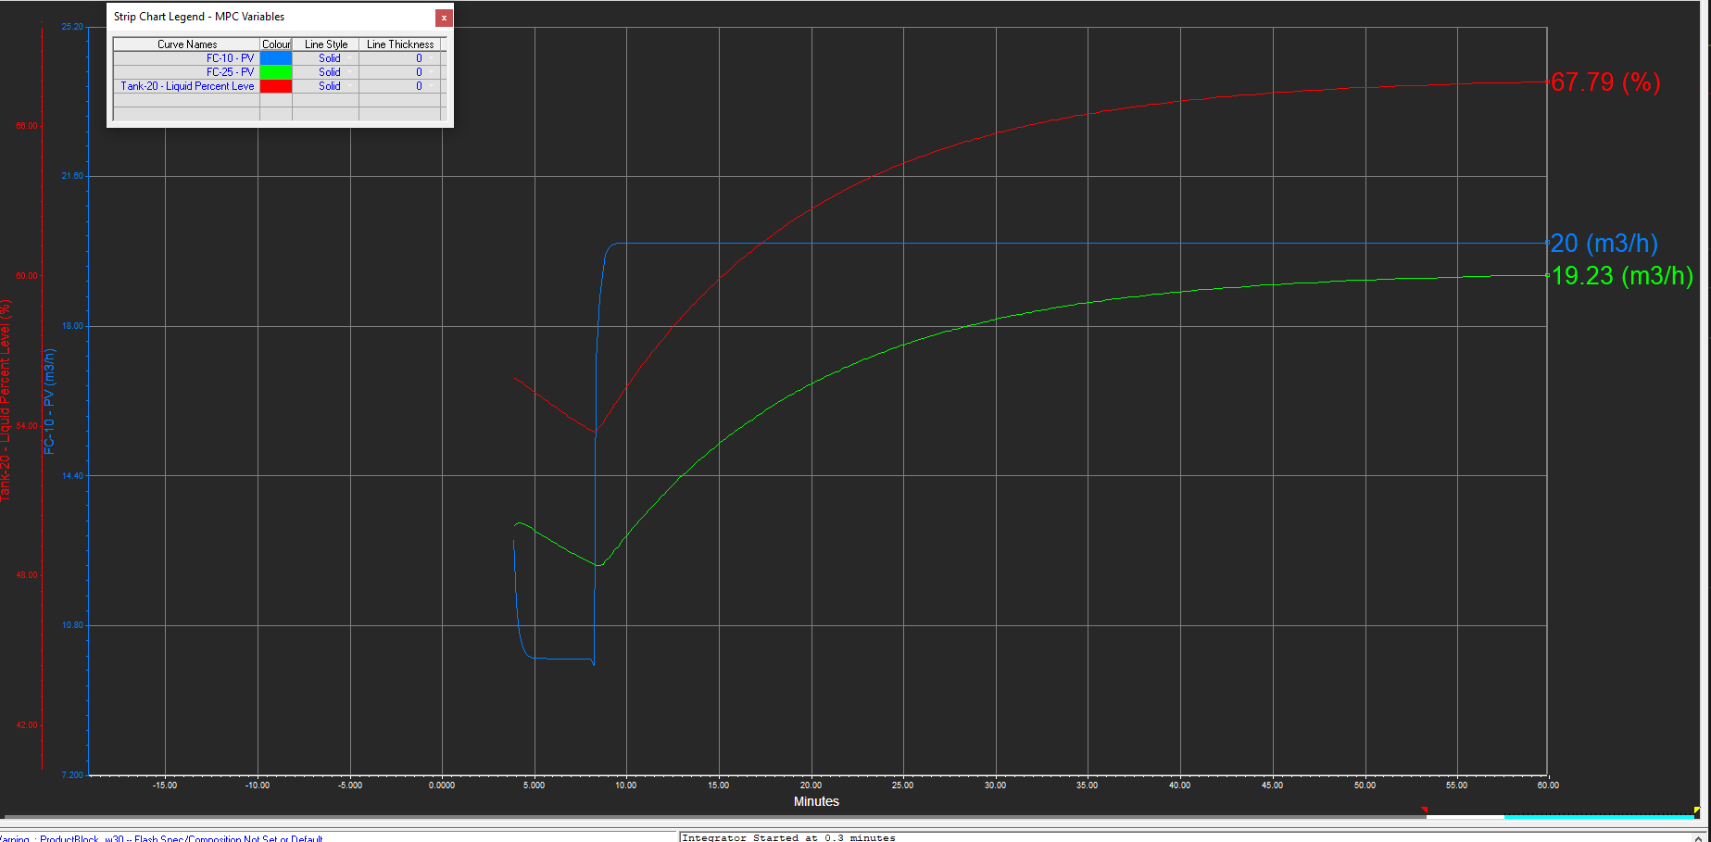
Comparison of Override and MPC
Model Predictive Control
Robustness of MPC
Optimal solution

Slide 26
Challenges and future work
Challenges
1. Change in local security settings for DCOM setting
2. Unavailability of ethernet port in one of the laptop
3. Finding the time constant of tank
4. Finding right states and parameters of MPC
Future Work
1. OPC UA
2. Real world testing
3. Fine tuning MPC

Slide 27
THANK YOU

